Slide 1
THE AMERICAN CONSTITUION
The foundation of America

Slide 2
THE ARTICLES OF CONFEDERATION
America’s First Government

Slide 3
The Story so Far
Colonies defeated Britain in the American Revolutionary War
With the victory 13 Colonies now independent
Colonial leaders now faced with task of creating a government to unify 13 independent states
After problems with British rule American people scared of government with strong CENTRAL GOVERNMENT

Slide 4
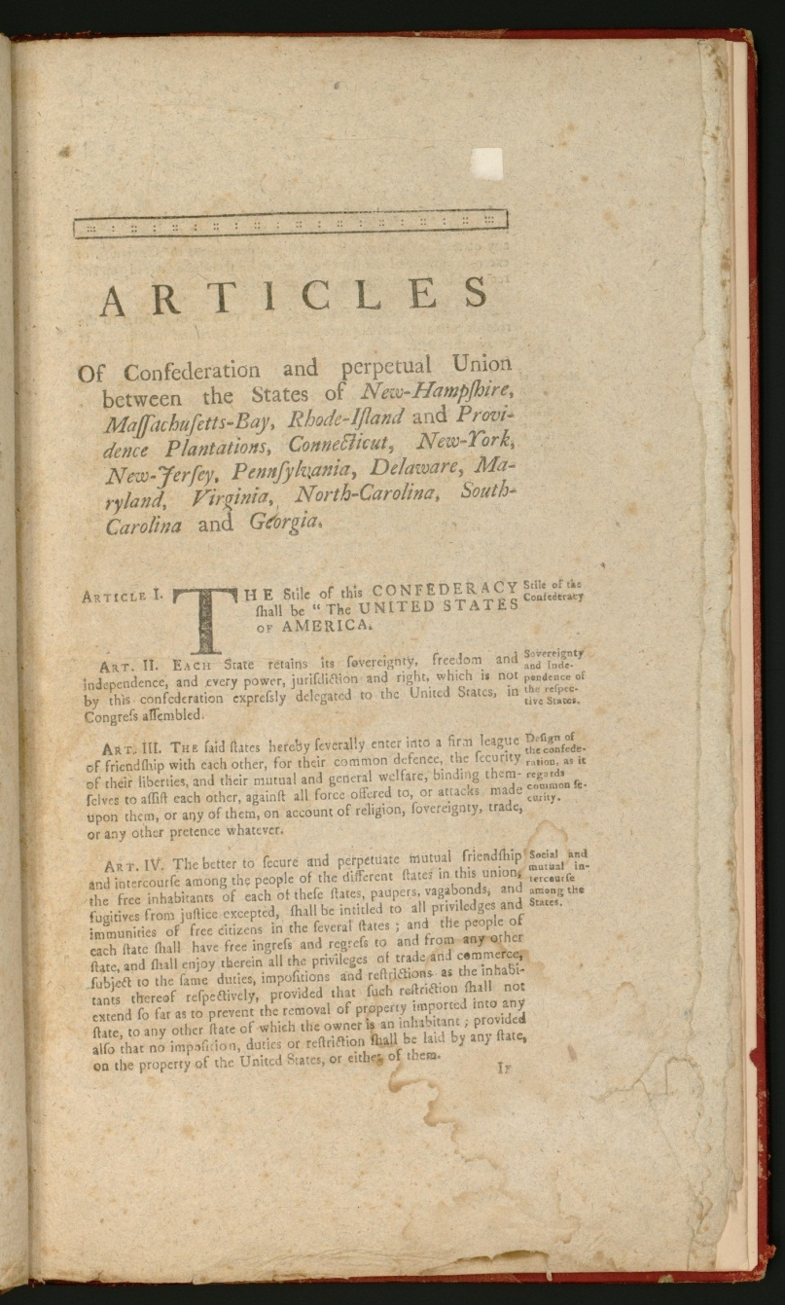
The Articles of Confederation
First National Government to unify 13 States
Went into effect 1781
Decentralized Government
Power is divided
Weak Central Government
State Governments held sovereignty (power)
Would cause future problems

Slide 5
Successes of the Articles
The Northwest Ordinance of 1787
Provided system of governing western territories
Significant because it created framework for admitting new states into the union

Slide 6
Failures of the Articles
Central Government lacked sovereignty (power) over state governments
This means central government had no power to tax, coin money, control trade
All these powers belonged to states
Also lacked power to create standing army which left colonies vulnerable to foreign power
Problems arose as no national currency led to problems with interstate trade and tariffs

Slide 7
Shay’s Rebellion
Massachusetts farmers rebelled against state government over high taxes
Former war hero Daniel Shay led the rebellion against state government
Rebellion was put down by a state military force

Slide 8
Shay’s Legacy
Rebellion exposed fundamental weaknesses in government under Articles of Confederation
People feared if rebellion had spread the government would have been powerless to stop it
Without the power to build a standing national army the government would have had no way of organizing a defense against the rebellion
This lead to the calling of the of the Constitutional convention of 1787

Slide 9
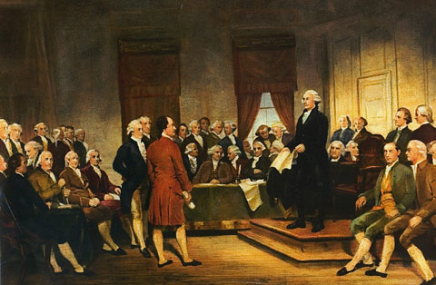
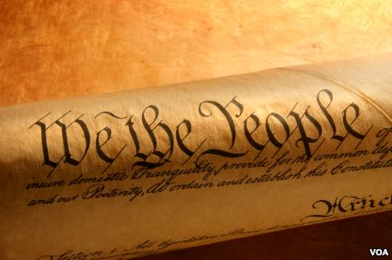
CONSTITUTIONAL CONVENTION OF 1787
“to decide forever the fate of Republican Government”
-James Madison

Slide 10
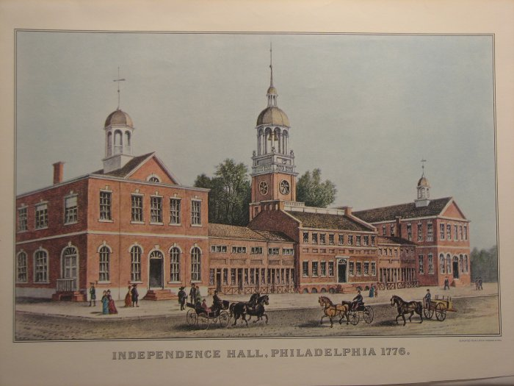
Setting The Stage
Shay’s Rebellion exposed the weaknesses of The Articles of Confederation
In response Constitutional Convention meets in Philadelphia
All states sent delegates except Rhode Island
Original purpose: fix Articles of Confederation

Slide 11
Issues on The Table
Agreements
Divisions
Need Stronger Central Government
Congress needs power to tax + regulate trade
Need for Executive (president) and Judicial (Federal Court) Branch of government
Revise Articles or Start From Scratch
Representation based on population or fixed (the same) representation for each state

Slide 12
The Virginia Plan
Representation based on Population
Congress has power to tax + Regulate trade
Establish: Executive, Judicial, and Bicameral legislature
Central Government can override state

Slide 13
The New Jersey Plan
Equal Representation for all states
Congress has power to tax + regulate trade
Establish: Executive, Judicial, one house legislature

Slide 14
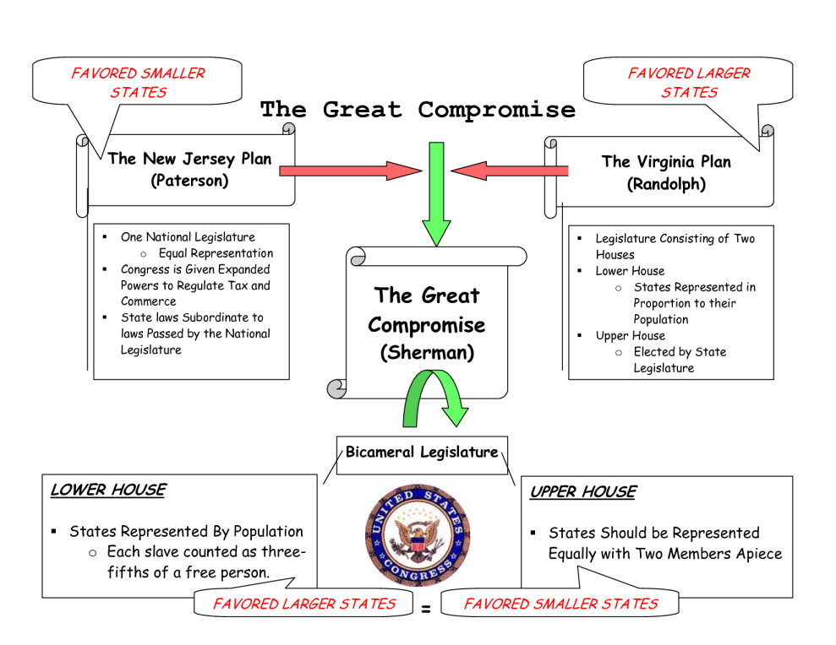
The Great Compromise
Two house Legislature
Senate
House of Representatives
Senate: Equal (2 per state) representation
House of Representatives: Determined by population
Makes both large and small states happy

Slide 15
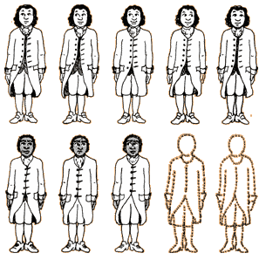
The 3/5ths Compromise
Approval of Great Compromise meant House of Reps. Determined by state pop.
Southern states wanted slaves counted in pop.
North (didn’t like slavery) said no
Two sides agreed to 3/5ths of the slave population being counted (meaning 60% of slaves would count toward state population)

Slide 16
Constitution Approved
Convention approves final draft of Constitution on September 17, 1787
Delegates all approved document
Still needed Ratfication from the states

Slide 17
The Issue of Ratification
Constitution still needed approval from the states

Slide 18
The Two Sides
Federalists
Anti-Federalists
Supporters of the new Constitution
Wanted strong national government
Favored in populated areas (NYC, Virginia)
Included: Washington, Madison, Hamilton John Jay
Opposed to the constitution
Believed constitution threatened state governments and individual rights
Favored in isolated areas (Rhode Island)
Led by Patrick Henry

Slide 19
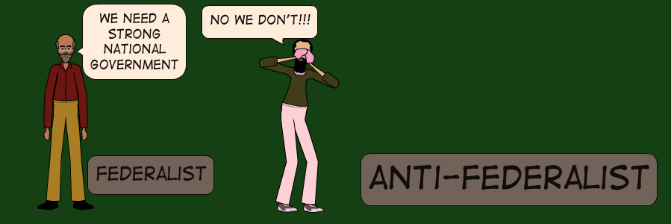
Federalist Argument
Federalists Papers-Series of essays argued in defense of the constitution
Published by, Madison, Hamilton, John Jay to raise support for ratification
Argued Checks and Balances would keep any one part of government from becoming too powerful

Slide 20
Antifederalists Argument
Feared national government having too much power
Thought President would be just like a King
State governments would be powerless to resist national government
Lacked a Bill of Rights
All other state constitutions included a bill of rights portion

Slide 21
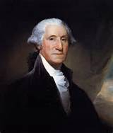
The Federalists Win
Shay’s Rebellion convinced Americans that changes needed
Federalists had a plan in place (The Constitution)
Federalists had George Washington (a national Hero all people respected + trusted)
Federalists agreed to include Bill of Rights

Slide 22
The Bill of Rights
Protected civil liberties (freedom of speech, assembly, press, etc.)
Similar to Declaration of Independence
Both docs. Stressed individual liberties
First 10 Amendments to the constitution

Slide 23
Constitution Ratified
1789 Constitution ratified by all states
1789 George Washington Inaugurated as First United States President

Slide 24
The Principles of the Constitution
The Concepts behind the Document

Slide 25
6 Primary Principles of the Constitution
Popular Sovereignty
Limited Government
Separation of Power
Checks and Balances
Judicial review
Federalism

Slide 26
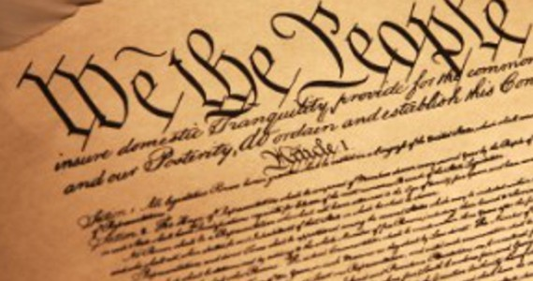
Popular Sovereignty and Limited Government
Popular Sovereignty- People hold power and government needs their consent
Limited Government-Government only has as much authority as people allow
Reflected in the Preamble (intro) of constitution

Slide 27
Separation of Power
Powers divided between three government branches: Legislative, Executive, Judicial
*Concept from enlightenment thinker Montesquieu*

Slide 28
Checks and Balances
Each branch has power restrain power of other branches
No one branch can holds too much power

Slide 29
Federalism
Power is shared between national and state governments
Result of Americans fear of a Strong Central government
Most of the law making power still held by the states

Slide 30
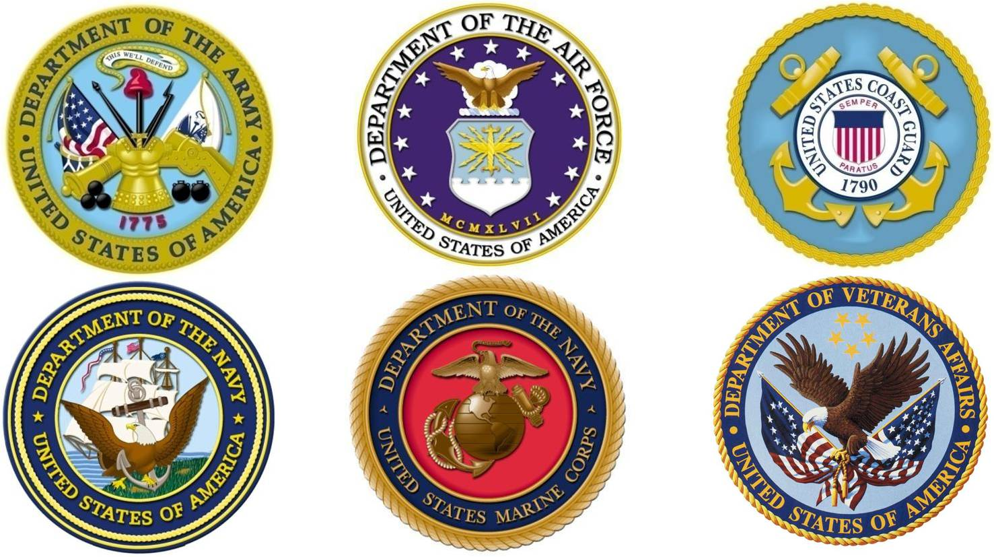
Delegated Powers
Powers only granted to the federal government by constitution
These Include:
Declaring War
Coining Money (producing Currency)
Regulate Foreign and Interstate trade
Maintain Armed Forces
Establish Foreign Policy

Slide 31
Reserved Powers
Powers not granted to the federal government “Reserved for the States”
This Includes:
Education
Marriage laws
Maintain local gov’ts
Create local laws
Regulate Intrastate trade
Provide public safety

Slide 32
Concurrent Powers
Powers shared by both federal and state governments
This includes:
Levy Taxes
Maintain Law and Order
Borrow Money
Start banks
Establish Courts
Provide for public welfare

Slide 33
The American Constitution
“A Living Document”

Slide 34
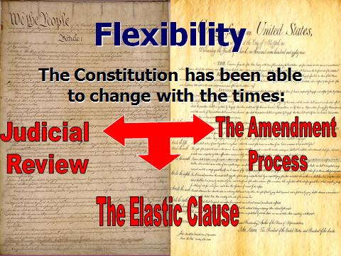
Flexibility of Constitution
Founding fathers structured the constitution so that it could be changed to meet needs of the constitution

Slide 35
Constitutional Amendments
Amendment process allows for changes to be made to the constitution to meet needs of a changing country
Amendment Process- Takes two steps to make
Pass by both houses of congress (Senate and House of Reps.) by 2/3rds vote
Ratified (approved through vote) by 3/4ths of states in the Union (currently 50)
First 10 amendments make up the Bill of Rights (Free speech, Religion, press, etc.)

Slide 36
The Second Amendment
The right to "A well regulated Militia, being necessary to the security of a free State, the right of the people to keep and bear Arms, shall not be infringed."
What do you think this means?
When was this written?
Is this still relevant today?
Should this still be a right?

Slide 37
Implied Powers
Under clause 18 the “necessary and proper” or “Elastic Clause” says congress can expand power based on the changes and needs of the country
Ex: Louisiana Purchase, Federal Reserve

Slide 38
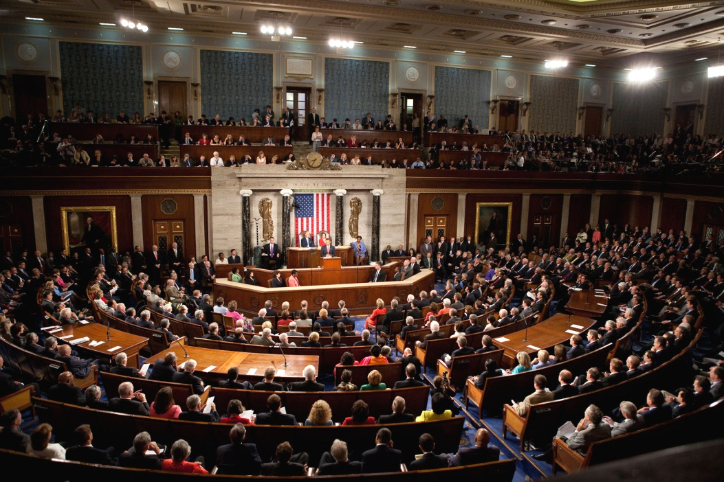
Article I-Legislative
Consists of House of Representatives and Senate
Main Purpose is to create laws
Other Jobs include:
Collect taxes
Maintain Military
Pay Debts

Slide 39
Additional Powers of Legislative
All laws related to Taxes must come from House of Representatives
Founders still afraid of Taxation without proper representation
House of reps. is the most direct voice people of the United States have
Senate given the power to approve all treaties
Approve Presidential appointments

Slide 40
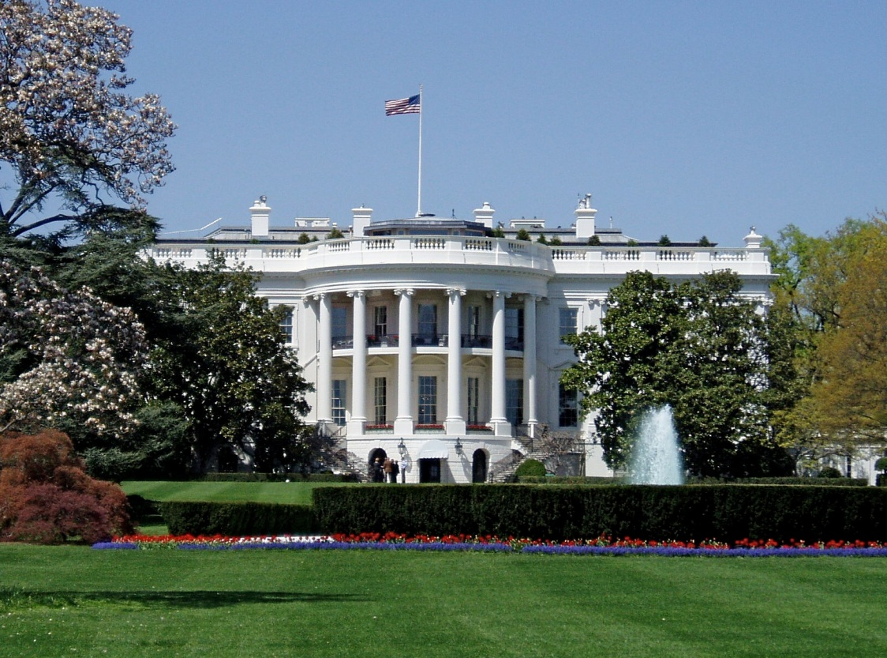
Article II-Executive
President head of executive branch
Main purpose is to enforce laws
Other Jobs include:
Sign or Veto Laws
Make Treaties
Pardon
Appoint-Judges, ambassadors, officials (if congress approves)

Slide 41
The Roles of the President
Chief of State- The living symbol of the nation, a example for all people to follow
Commander in Chief- All important military decisions come from the president, commands, military bases, heavy weapons deployment
Chief Legislator- Can suggest and lobby for laws, signs laws into power, can veto laws
Chief Diplomat- President makes foreign policy decisions, appoints ambassadors, make treaties
Chief Executive- president is head of all Federal agencies, departments and bureaucracy within executive branch

Slide 42
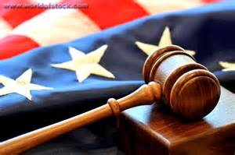
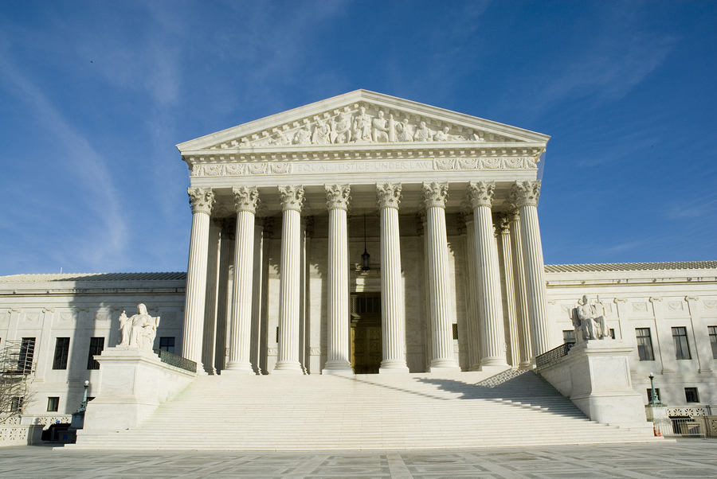
Article III-Judicial
Made up of Supreme court and Federal Courts
Main Purpose is to interpret laws
Other powers include:
Judicial Review-supreme court has power to declare laws unconstitutional
(established by Marbury vs. Madison)

Slide 43
Marbury vs. Madison
Historical Context: John Adams Defeated by Jefferson in election of 1800
Adams as “lame duck” president appoints federalist judges as final act as president
New Secretary of state James Madison refused to deliver the commissions
Marbury one of the judges sues Madison based on Judiciary act of 1789
Decision: Court led by John Marshall declares Judiciary Act of 1789 unconstitutional

Slide 44
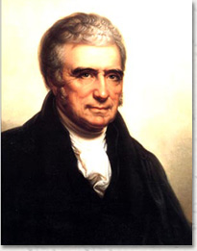
Legacy of Marbury vs. Madison
Legacy: Establishes the power of judicial review for the supreme court
Significant as this power strengthened the power of the supreme court.
Marks first time supreme court declared a federal law unconstitutional
John Marshall Established Judicial Review

Slide 45
The Unwritten Constitution
Unwritten Constitution-Powers and customs based on tradition not actually in constitution
Many traditions established by early presidents and leaders such as Washington and Supreme court justice John Marshall
Ex: Judicial Review, Lobbying, Political Parties, Presidential Cabinet
George Washington set precedent of Presidential Cabinet

