Slide 1
The Colonial Period
The road to revolution

Slide 2
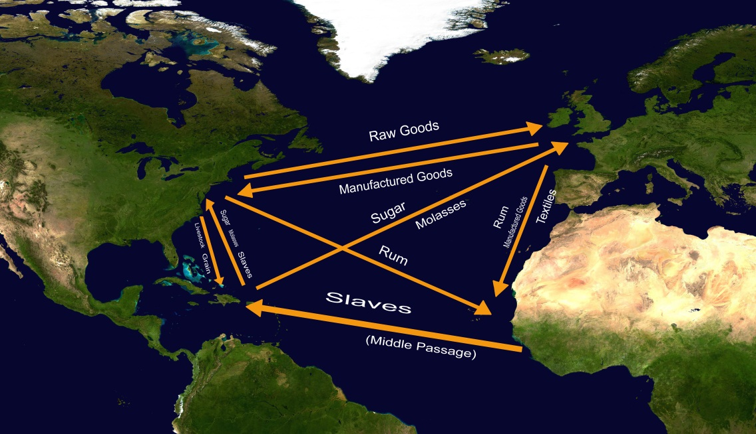
Basis of American Colonies
Agricultural based life style
Provides stable food for colonists
Triangle Trade-Brought many Africans to American Colonies for slave labor
Southern economy dependent on slave labor for production

Slide 3
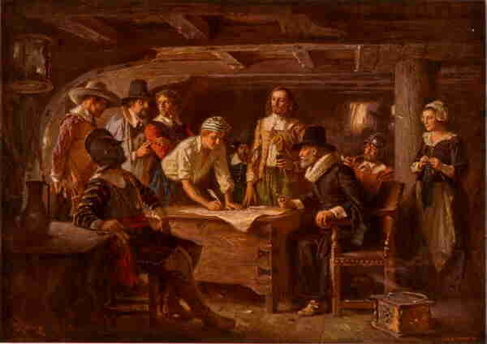
Roots of democracy
Colonies democratic ideas originally inspired by traditions of English Parliament (representative gov’t)
Mayflower Compact and House of Burgesses in Virginia are early practices of democratic ideas in the colonies

Slide 4
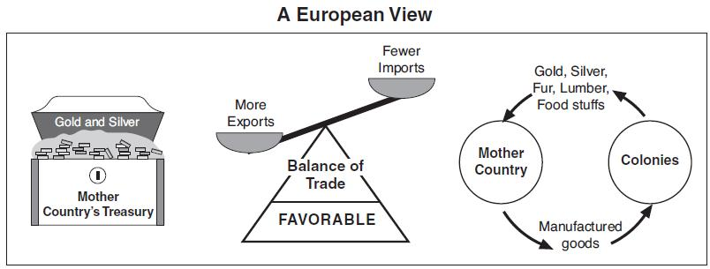
Policy of mercantilism
Mercantilism- raw materials from colonies to manufacture goods which are then sold to the colonists
Provides materials and market for goods
Limits Colonial interactions with other Countries
Would later serve as a cause of Revolution

Slide 5
Salutary neglect
England Profited greatly from colonies
Resulted in England only caring about economic aspects of Colonies
Due to this Colonies becoming used to ruling and governing themselves
(leads to rebellion when English try to re-take control of them)

Slide 6
French and Indian war
War fought over land disputes in America between Great Britain and France (as well as Native Americans)
Costs Great Britain A lot of Money
To make up cost start to tax colonies
Marks the end of Salutary Neglect
These taxes become primary reason for the American Revolution

Slide 7
Independence movement
American Revolution

Slide 8
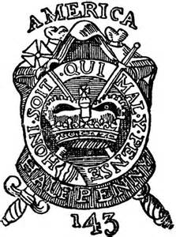
Impact of the French Indian War
As a result of French Indian War Britain Taxed Colonies to pay off large debt
These Taxes include:
Sugar Tax-tax for foreign molasses
Stamp Tax-Tax on printed material
Townshend Act-Tax on imported goods
Tea Tax-Tax on imported tea
Quartering Act-Colonists must house and feed British soldiers

Slide 9
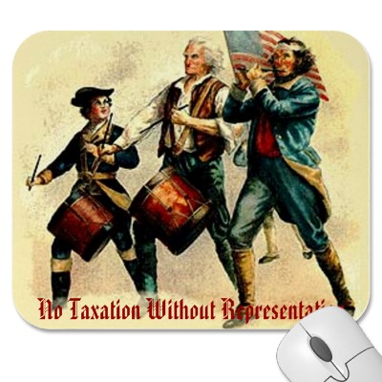
“No taxation without representation”
Colonists protested against new taxes
Felt with no representation in British government they had no right to impose new taxes on colonies
Britain did not have Consent of the Governed
Consent of the governed-
a major theme of the
declaration of independence

Slide 10
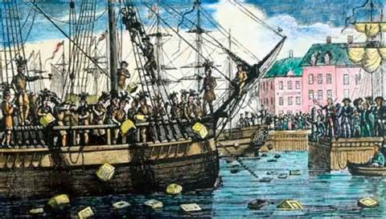
“No taxation without representation” cont.
New taxes led to protests and boycotts of British goods
Represents Colonial response to British Mercantilism
Hurts British manufacturing companies (colonies 1/7th of their business)
Example: Boston Tea Party-Boston mob dumps British tea into harbor to protest the tea tax

Slide 11
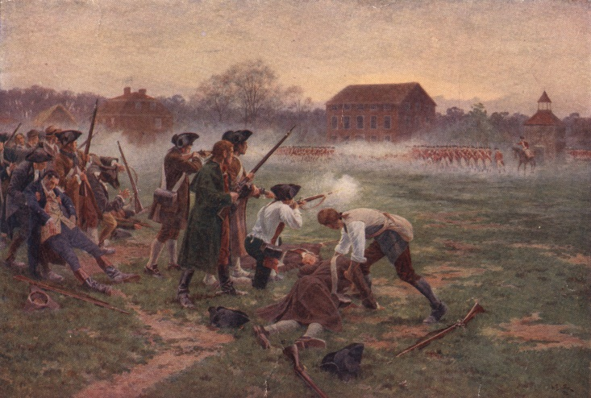
The war breaks out
Revolutionary war starts in
1775 at Lexington and Concord
Starts as war for colonial rights within the British empire
Originally many colonists were afraid of independence from Great Britain
As war waged colonists become split as to the purpose of war
Colonial rights as Englishman Vs. war for colonial independence

Slide 12
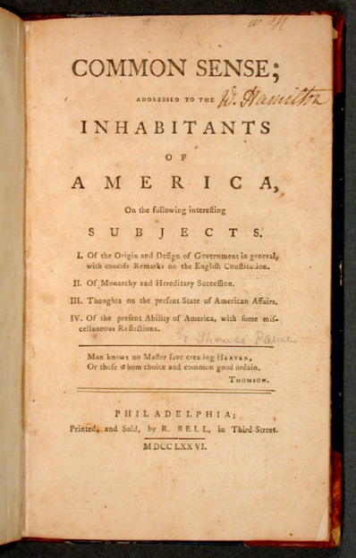
Thomas Paine’s Common sense
Public opinion towards independence changes with the publishing of pamphlet Common Sense
Stated ridiculous for large continent a ocean away like America to be ruled by tiny island in Europe
Convinced undecided colonists that independence from British was best

Slide 13
The Declaration of independence
The birth of America

Slide 14
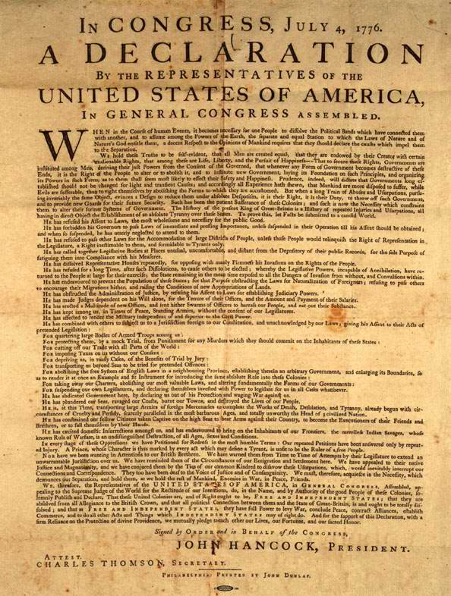
July 4 1776
Shortly after outbreak of war America signs Declaration of Independence During Second Continental Congress
Witten by Thomas Jefferson
States the Grievances (complaints) against British Rule

Slide 15
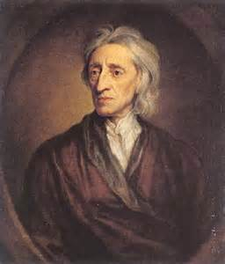
Influences of declaration
Jefferson Greatly influenced by thinkers of the Enlightenment
Based the declaration around enlightenment ideas
For Example: John Locke’s “Theory of Natural Rights”- That power belongs to the people in a government not the leaders of government
Remember-”consent of the governed”

Slide 16
Social contract theory of government
Purpose of a government is to secure the natural rights of people
If government does not meet the rights of their people, the people justified in overthrowing it.
This theory is what the Declaration of Independence is based on
and United States Government based on this idea as well
(also our school!!!!)

Slide 17
The Declaration itself
Declaration is simply a list of reasons the U.S. wanted to break from Britain
No plans for a government structure
More similar to the Bill of Rights than the constitution
Only concerned with what the government should not do not what it should do

Slide 18
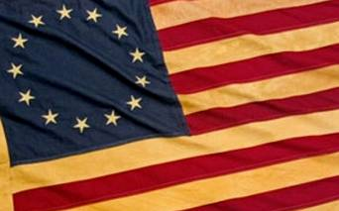
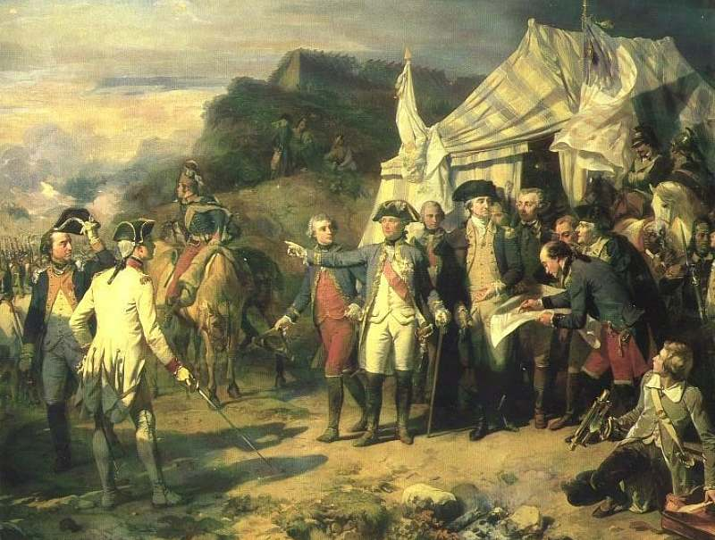
American Independence
With the help of the French (who hated Britain more than we did) U.S. defeats Great Britain
Would not have won without French Help
In 1783 Great Britain recognizes the 13 independent colonies in America

